Slide 1
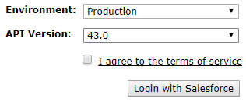
Login page [Page 1]
Org 1
Org 2

Slide 2
List difference page [Page 2]
Class | Trigger | Vf pages | Objects | Labels
Metadata | Last modified | Last modifiedby
Class1 | 12-10-2017 | RK Roy
Class2 | 12-10-2017 | RK Roy
Class3 | 12-10-2017 | RK Roy
Class4 | 12-10-2017 | RK Roy
Class5 | 12-10-2017 | RK Roy
Metadata | Last modified | Last modifiedby
Class1 | 12-10-2017 | RK Roy
Class2 | 12-10-2017 | RK Roy
Class3 | 12-10-2017 | RK Roy
Class5 | 12-10-2017 | RK Roy
Move this class to org2
Org 1
Org 2

Slide 3
Content difference [Page 3]
Org 1
Org 2
Public class Class1{
Public static void printHelloWorld (){
System.debug(‘Hello world’);
}
}
Public class Class1{
Public static void printHelloWorld (){
}
}
Move this line to org2
Update
Update
Edit mode
Edit mode

